Slide 1
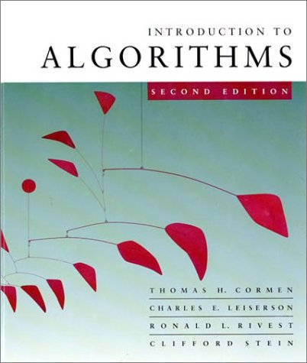
Divide-and-Conquer Algorithm: An Idea of Master Theorem

Slide 2
Integer Multiplication
Let X = A B and Y = C D be the n bit integers, where A, B, C and D are n/2 bit integers
Simple Method: XY = (A.2^{n/2}+B)(C.2^{n/2}+D)
Running Time Recurrence
T(n) < 4T(n/2) + 100n
How do we solve it?

Slide 3
Substitution Method
The most general method:
Guess the form of the solution.
Verify by induction.
Solve for constants.
Example: T(n) = 4T(n/2) + 100n
[Assume that T(1) = Θ(1).]
Guess O(n³) . (Prove O and Ω separately.)
Assume that T(k) ≤ ck³ for k < n .
Prove T(n) ≤ cn³ by induction.

Slide 4
Example of Substitution
T
(
n
)
=
4
T
(
n
/
2
)
+
100n
≤
4
c
(
n
/
2
)
3
+
100n
=
(
c
/
2
)
n
3
+
100n
=
cn
3
−
((
c
/
2
)
n
3
−
100n
)
Desired – Residual
≤
cn
3
Desired
whenever (c/2)n³ – 100n ≥ 0, for example, if c ≥ 200 and n ≥ 1.
Residual

Slide 5
Example (continued)
We must also handle the initial conditions, that is, ground the induction with base cases.
Base: T(n) = Θ(1) for all n < n₀, where n₀ is a suitable constant.
For 1 ≤ n < n₀, we have “Θ(1)” ≤ cn³, if we pick c big enough.
This bound is not tight!

Slide 6
A Tighter Upper Bound?
We shall prove that T(n) = O(n²).
Assume that T(k) ≤ ck² for k < n:
T
(
n
)
=
4
T
(
n
/
2
)
+
100n
≤
cn
2
+
100n
≤
cn
2
for no choice of c > 0. Lose!

Slide 7
A Tighter Upper Bound!
IDEA: Strengthen the inductive hypothesis.
Subtract a low-order term.
Inductive Hypothesis: T(k) ≤ c₁k² – c₂k for k < n.
T
(
n
)
=
4
T
(
n
/
2
)
+
100n
≤
4
(
c
(
n
/
2
)
2
−
c
(
n
/
2
))
+
100n
1
2
=
c
n
2
−
2
c
n
+
100n
1
2
=
c
n
2
−
c
n
−
(
c
n
−
)
1
2
100n
2
≤
c
n
2
−
c
n
if c₂ > 100.
1
2
Pick c₁ big enough to handle the initial conditions.

Slide 8
Recursion-Tree Method
A recursion tree models the costs (time) of a recursive execution of an algorithm.
The recursion tree method is good for generating guesses for the substitution method.
The recursion-tree method can be unreliable, just like any method that uses ellipses (…).
The recursion-tree method promotes intuition (common sense, instinct, perception).

Slide 9
Example of Recursion Tree
Solve T(n) = T(n/4) + T(n/2) + n²:

Slide 10
Example of Recursion Tree
Solve T(n) = T(n/4) + T(n/2) + n²:
T(n)

Slide 11
Example of Recursion Tree
Solve T(n) = T(n/4) + T(n/2) + n²:
n²
T(n/4)
T(n/2)

Slide 12
Example of Recursion Tree
Solve T(n) = T(n/4) + T(n/2) + n²:
n²
(n/4)²
(n/2)²
T(n/16)
T(n/8)
T(n/8)
T(n/4)

Slide 13
Example of Recursion Tree
Solve T(n) = T(n/4) + T(n/2) + n²:
n²
(n/4)²
(n/2)²
(n/16)²
(n/8)²
(n/8)²
(n/4)²
…
Θ(1)

Slide 14

Example of Recursion Tree
Solve T(n) = T(n/4) + T(n/2) + n²:
n²
(n/4)²
(n/2)²
(n/16)²
(n/8)²
(n/8)²
(n/4)²
…
Θ(1)

Slide 15
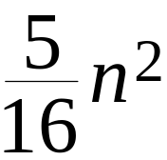
Example of Recursion Tree
Solve T(n) = T(n/4) + T(n/2) + n²:
n²
(n/4)²
(n/2)²
(n/16)²
(n/8)²
(n/8)²
(n/4)²
…
Θ(1)

Slide 16
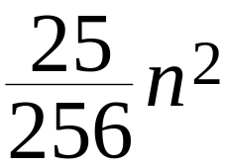
Example of Recursion Tree
Solve T(n) = T(n/4) + T(n/2) + n²:
n²
(n/4)²
(n/2)²
(n/16)²
(n/8)²
(n/8)²
(n/4)²
…
…
Θ(1)

Slide 17
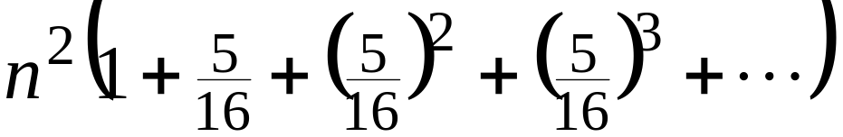
Example of Recursion Tree
Solve T(n) = T(n/4) + T(n/2) + n²:
n²
(n/4)²
(n/2)²
(n/16)²
(n/8)²
(n/8)²
(n/4)²
…
…
Θ(1)
Total =
= Θ(n²)
Geometric Series

Slide 18
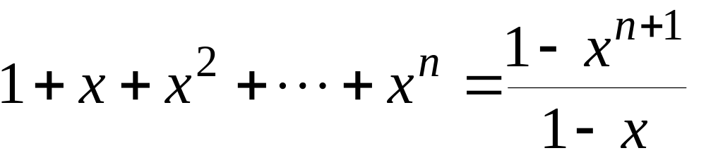
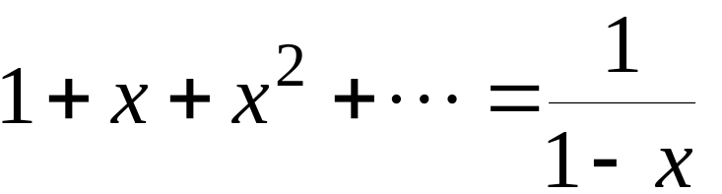
Appendix: Geometric Series
for x ≠ 1
for |x| < 1
Return to last slide viewed.

Slide 19
The Master Method
The master method applies to recurrences of the form
T(n) = a T(n/b) + f (n) ,
where a ≥ 1, b > 1, and f is asymptotically positive.

Slide 20
Idea of Master Theorem
Recursion Tree:
f (n)
f (n)
a
f (n/b)
f (n/b)
…
f (n/b)
a f (n/b)
a
h = log_{b}n
f (n/b²)
f (n/b²)
…
f (n/b²)
a² f (n/b²)
…
…
#leaves = a^{h}
= a^{logbn}
= n^{logba}
n^{logba}Τ (1)
Τ (1)

Slide 21
Three Common Cases
Compare f (n) with n^{logba}:
f (n) = O(n^{logba – ε}) for some constant ε > 0.
  f (n) grows polynomially slower than n^{logba} (by an n^{ε} factor).
Solution: T(n) = Θ(n^{logba}) .

Slide 22
Idea of Master Theorem
Recursion Tree:
f (n)
f (n)
a
f (n/b)
f (n/b)
…
f (n/b)
a f (n/b)
a
h = log_{b}n
f (n/b²)
f (n/b²)
…
f (n/b²)
a² f (n/b²)
…
…
CASE 1: The weight increases geometrically from the root to the leaves. The leaves hold a constant fraction of the total weight.
n^{logba}Τ (1)
Τ (1)
Θ(n^{logba})

Slide 23
Three Common Cases
Compare f (n) with n^{logba}:
f (n) = Θ(n^{logba} lg^{k}n) for some constant k ≥ 0.
  f (n) and n^{logba} grow at similar rates.
  Solution: T(n) = Θ(n^{logba} lg^{k+1}n) .

Slide 24
Idea of Master Theorem
Recursion tree:
f (n)
f (n)
a
f (n/b)
f (n/b)
…
f (n/b)
a f (n/b)
a
h = log_{b}n
f (n/b²)
f (n/b²)
…
f (n/b²)
a² f (n/b²)
…
…
CASE 2: (k = 0) The weight is approximately the same on each of the log_{b}n levels.
n^{logba}Τ (1)
Τ (1)
Θ(n^{logba}lg n)

Slide 25
Three Common Cases (cont.)
Compare f (n) with n^{logba}:
f (n) = Ω(n^{logba + ε}) for some constant ε > 0.
  f (n) grows polynomially faster than n^{logba} (by an n^{ε} factor),
and f (n) satisfies the regularity condition that a f (n/b) ≤ c f (n) for some constant c < 1.
Solution: T(n) = Θ( f (n) ) .

Slide 26
Idea of Master Theorem
Recursion Tree:
f (n)
f (n)
a
f (n/b)
f (n/b)
…
f (n/b)
a f (n/b)
a
h = log_{b}n
f (n/b²)
f (n/b²)
…
f (n/b²)
a² f (n/b²)
…
…
CASE 3: The weight decreases geometrically from the root to the leaves. The root holds a constant fraction of the total weight.
n^{logba}Τ (1)
Τ (1)
Θ( f (n))

Slide 27
Examples
Ex. T(n) = 4T(n/2) + n
a = 4, b = 2 ⇒ n^{logba} = n²; f (n) = n.
CASE 1: f (n) = O(n^{2 – ε}) for ε = 1.
∴ T(n) = Θ(n²).
Ex. T(n) = 4T(n/2) + n²
a = 4, b = 2 ⇒ n^{logba} = n²; f (n) = n².
CASE 2: f (n) = Θ(n²lg⁰n), that is, k = 0.
∴ T(n) = Θ(n²lg n).

Slide 28
Examples
Ex. T(n) = 4T(n/2) + n³
a = 4, b = 2 ⇒ n^{logba} = n²; f (n) = n³.
CASE 3: f (n) = Ω(n^{2 + ε}) for ε = 1
and 4(cn/2)³ ≤ cn³ (reg. cond.) for c = 1/2.
∴ T(n) = Θ(n³).
Ex. T(n) = 4T(n/2) + n²/lg n
a = 4, b = 2 ⇒ n^{logba} = n²; f (n) = n²/lg n.
Master method does not apply. In particular, for every constant ε > 0, we have n^{ε} = ω(lg n).

